Slide 1
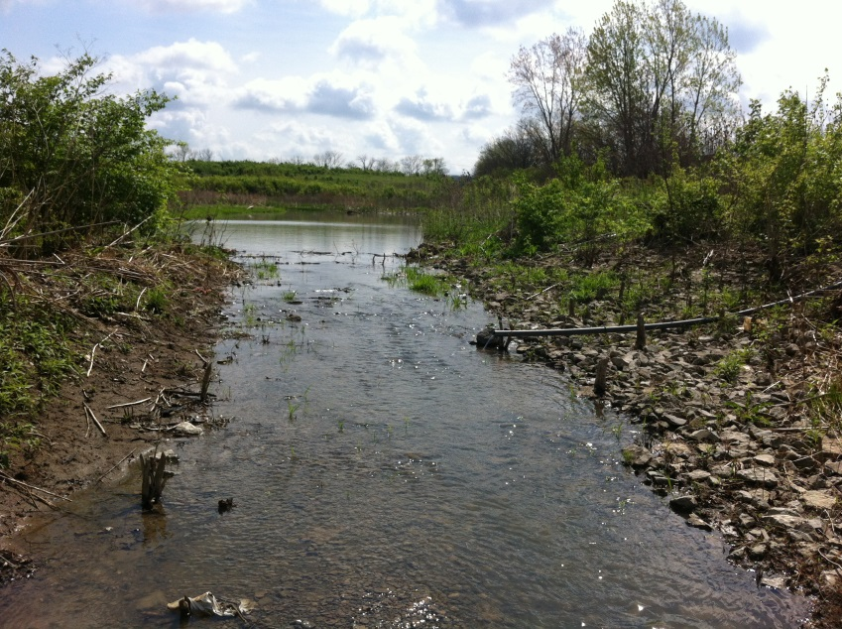
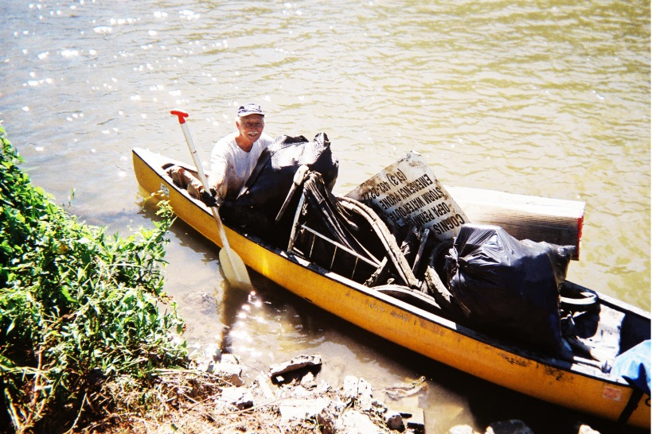
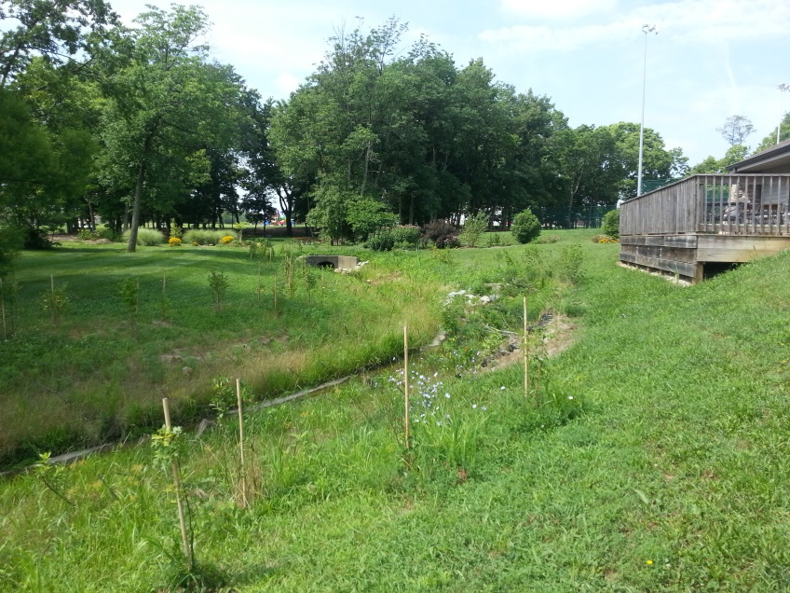
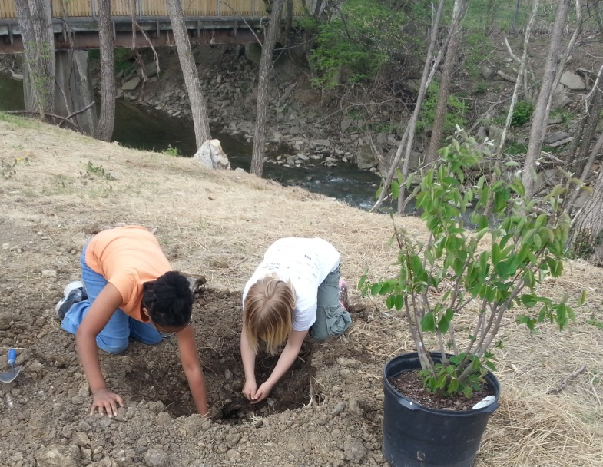
Quantifying the Benefits of Improvement Projects in an Urban Watershed

Slide 2
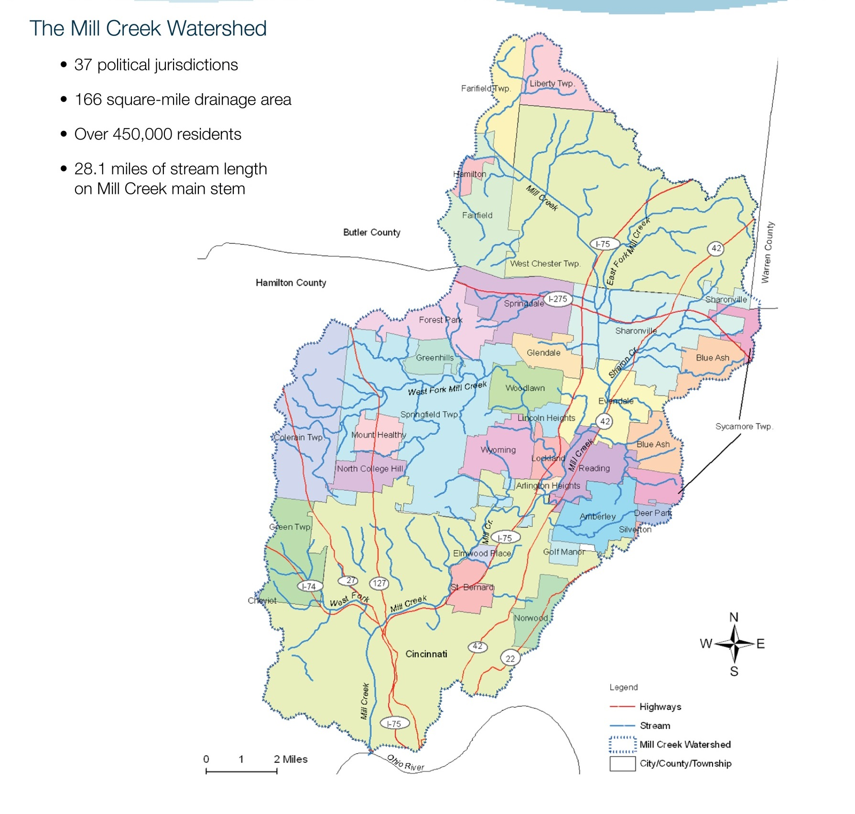
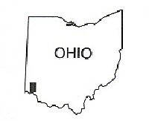
The Mill Creek Watershed
166 square miles
450,000 residents
28 miles of stream length on main stem
average 34% impervious surface
34 communities
2 counties
1 conservancy district
3 wastewater utilities
5 drinking water utilities
10 MS4s and many more industrial NPDES permit-holders

Slide 3
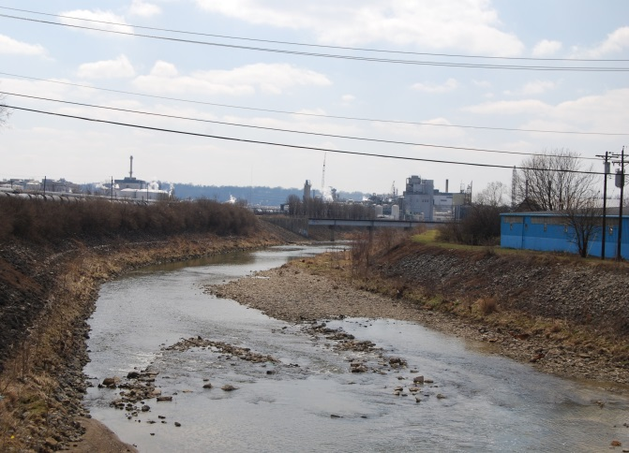
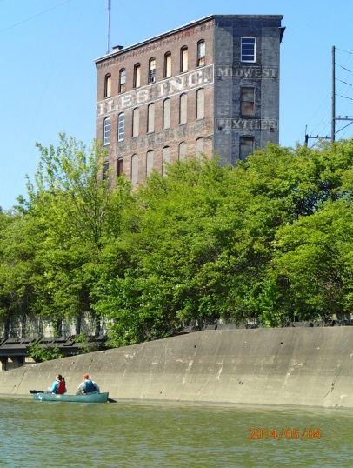
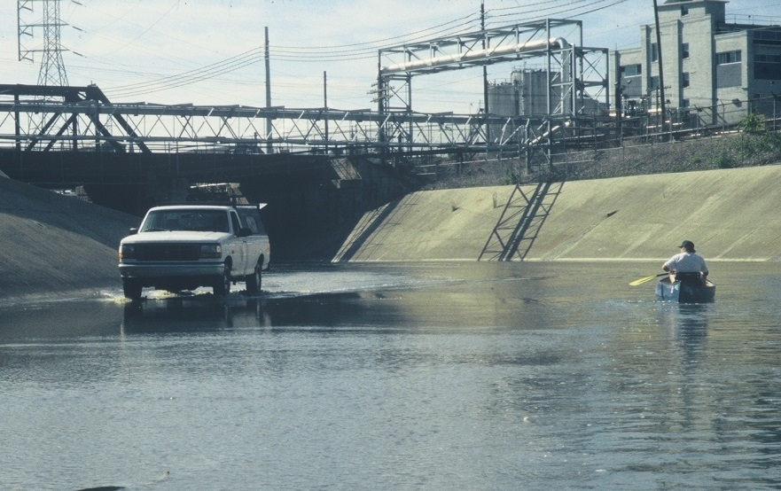
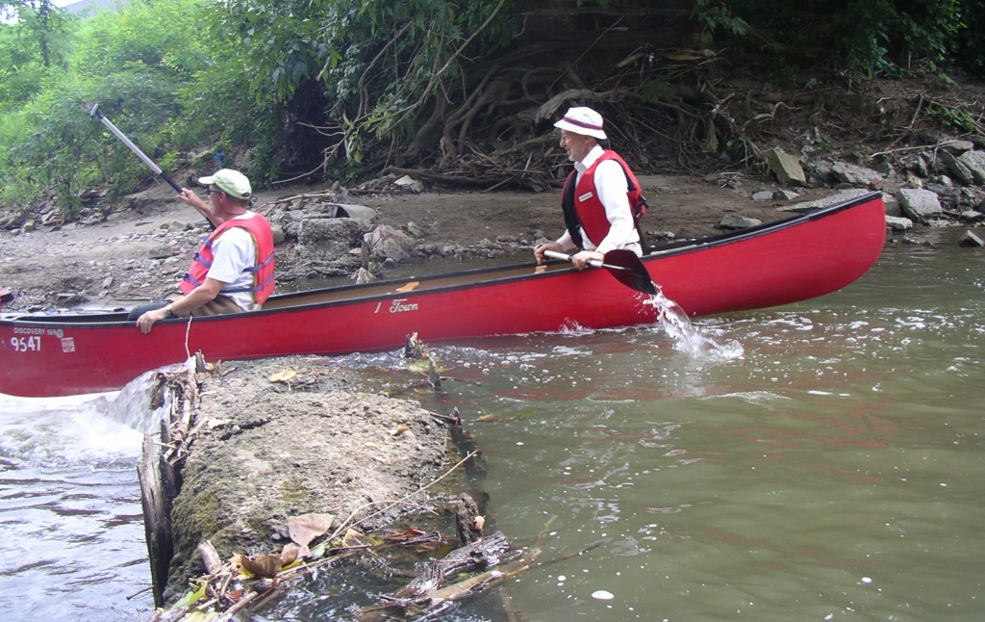
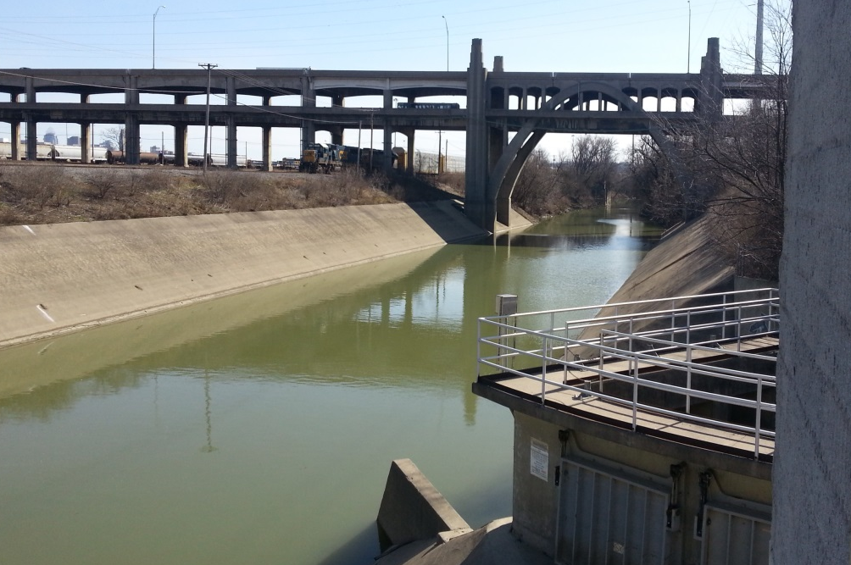
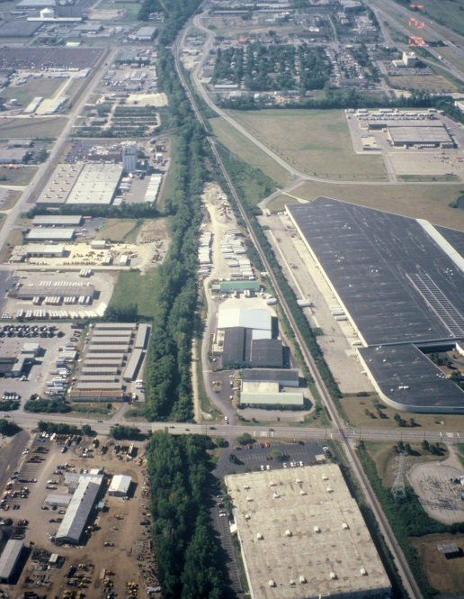
multi-modal transportation
recreational opportunity
a ribbon of
green
urban vistas
Notes:
In the late 1700s, permanent settlement started an onslaught of land clearing, burning and plowing that swept northward like a slow-motion wave. The Mill Creek Valley was the first land extensively farmed in Southwest Ohio because of its rich soils, relative flatness, abundant groundwater and easy access to Eastern markets. Here is a pioneer farmstead in the Price Hill area.

Slide 4
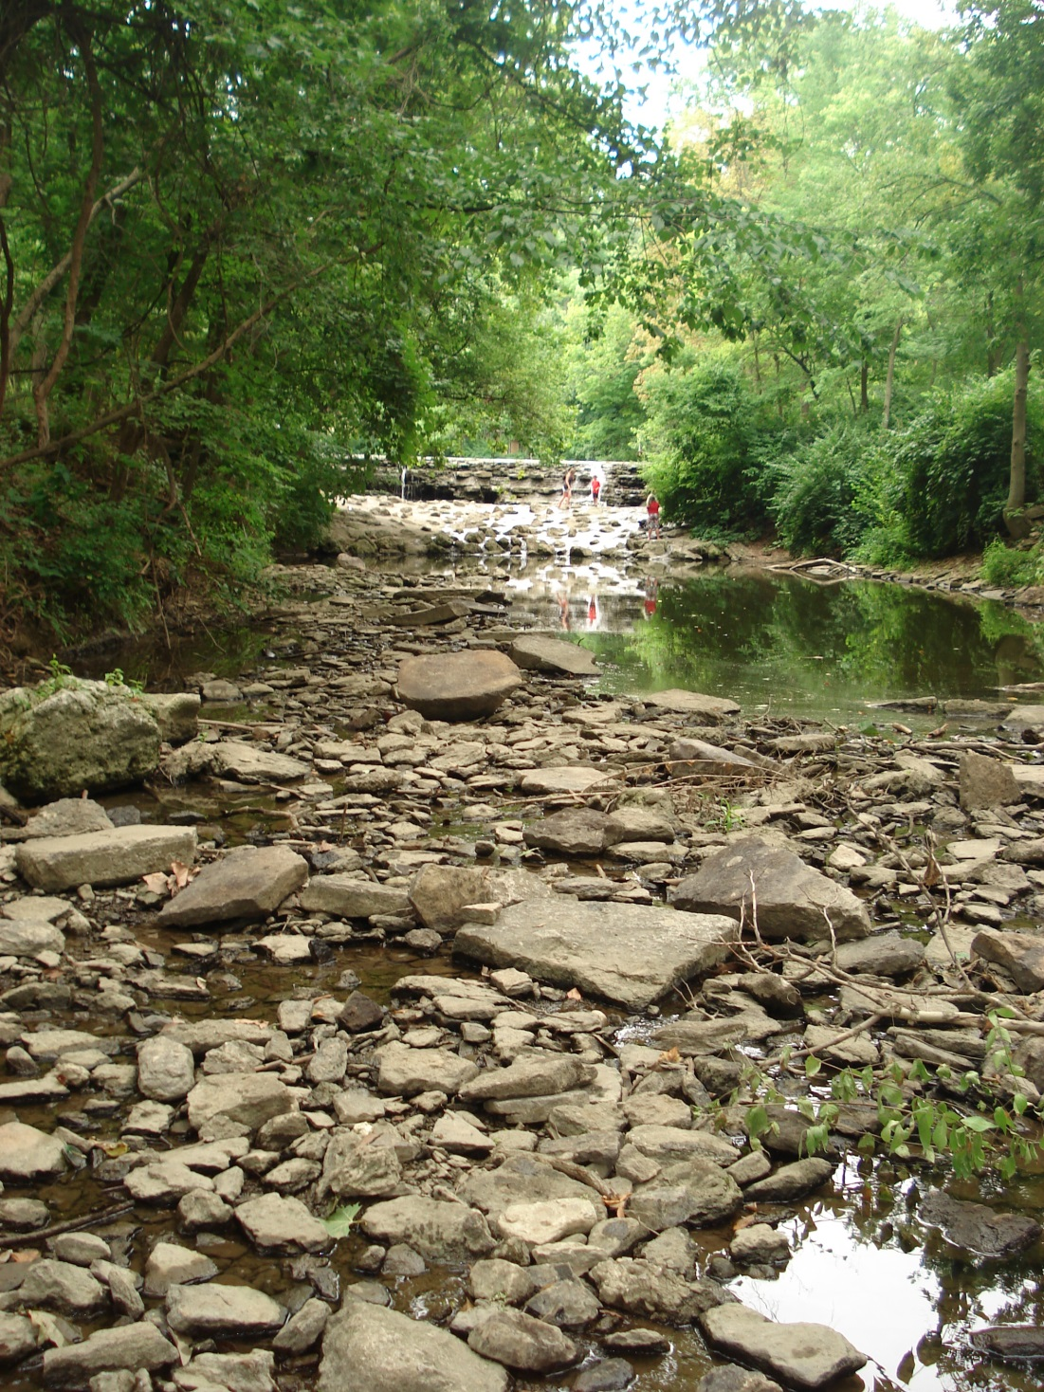
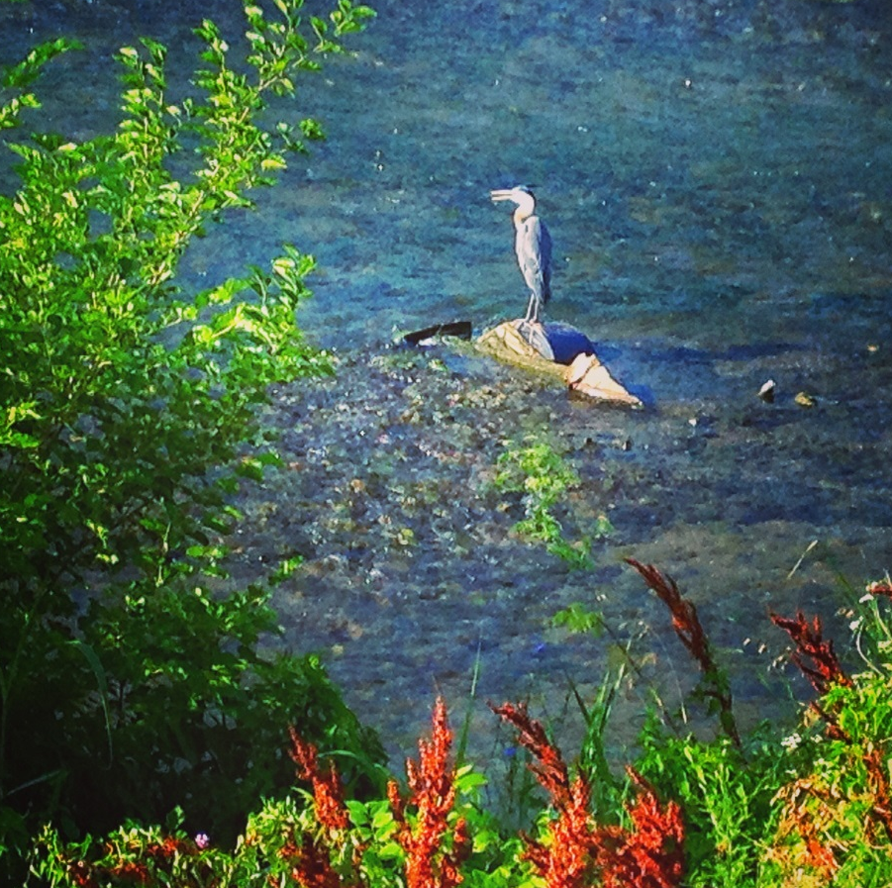
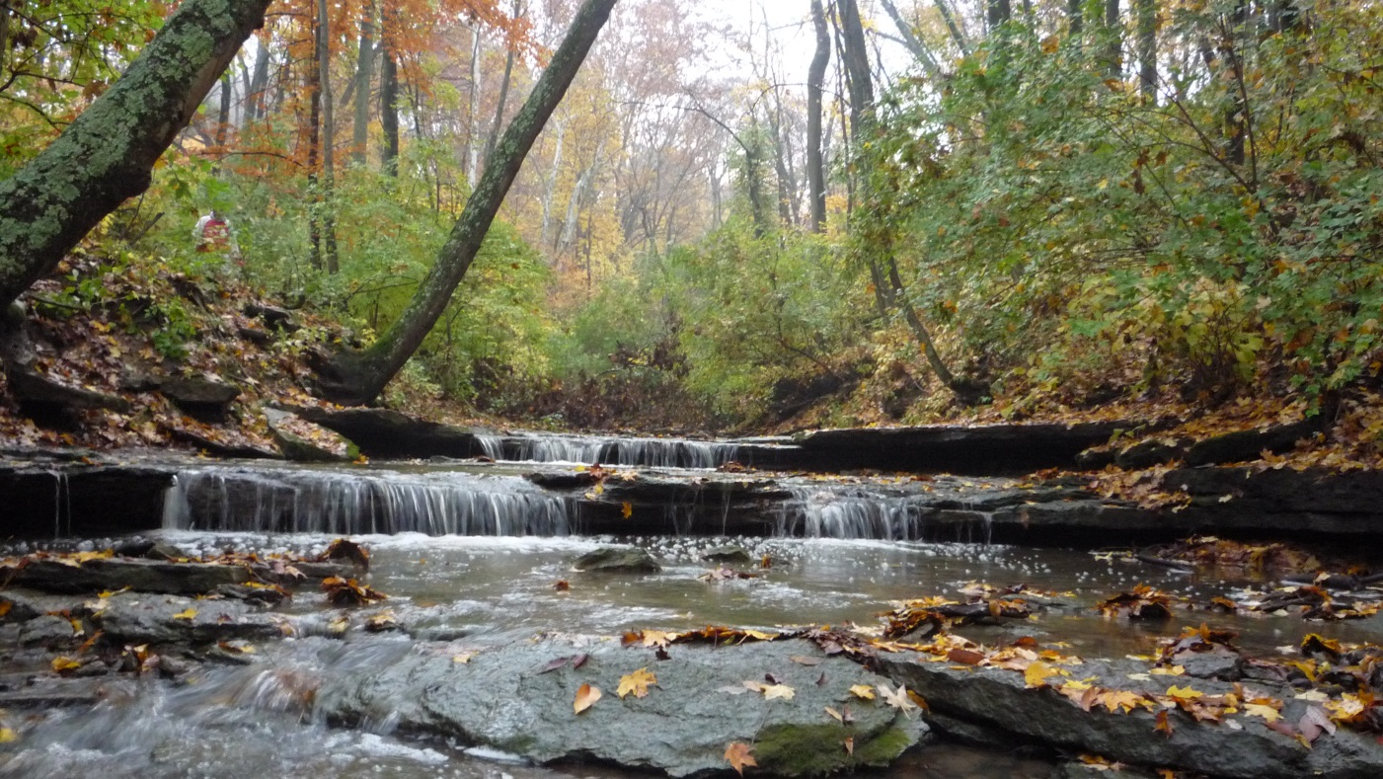
The Vision
An improved Mill Creek that is an asset to our region

Slide 5
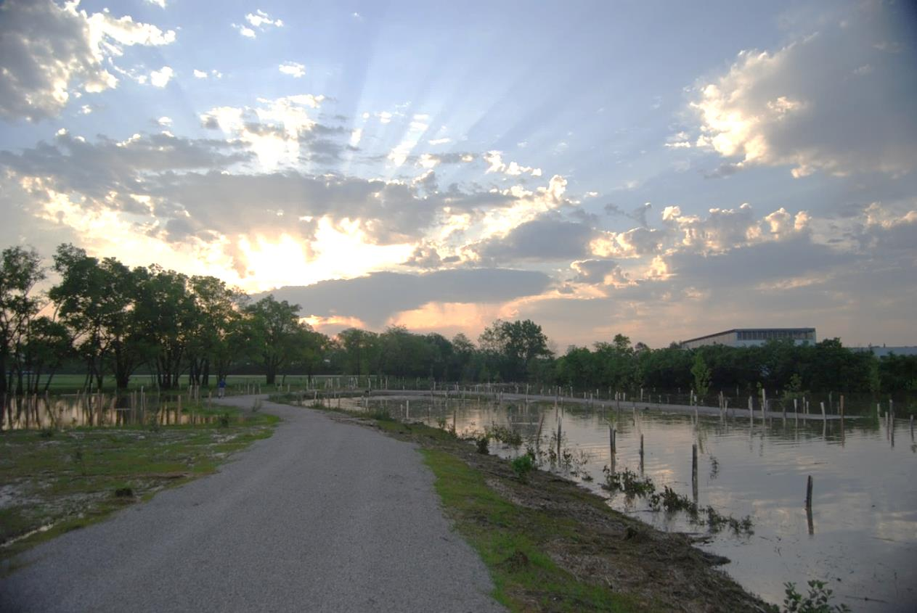
The Mill Creek Watershed Council of Communities
Building Consensus Around Our Shared Water Resource
Project Implementation
Advancing Research and Knowledge
Watershed Action Planning
Opportunity to Know Your Watershed
Notes:
MCWCC represents a diverse body of stakeholders in the watershed. Members and partners represent corporations, small businesses, local and state political jurisdictions and organizations, non-profit organizations, residents, volunteers, and students. We are a member supported organization and believe strongly in maintaining collaborative partnerships in the Watershed to successfully meet our mission and vision

Slide 6
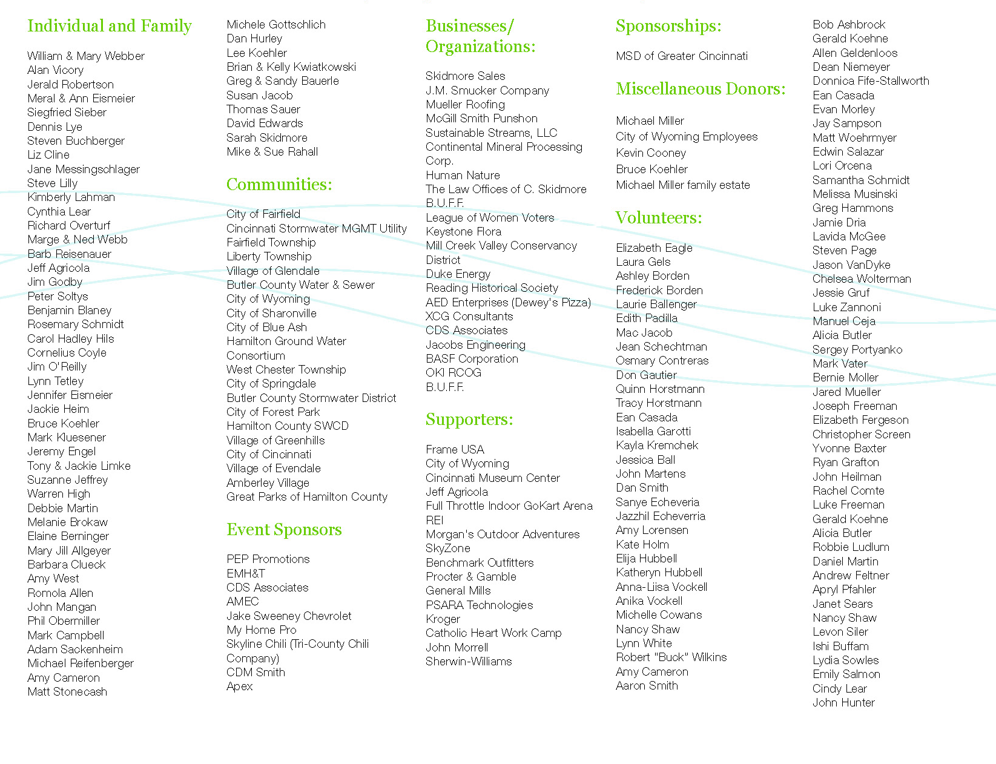
Strategic Partnerships
Communities
Businesses
Residents and Individuals
Elected Officials Decision-makers
Local, State and Federal Agencies
Volunteers
Utilities
Regulators
Funders
Non-profit Organizations
Technical Partners
Research Institutions

Slide 7
Causes & Sources of Impairment
Causes: the specific chemical, biological, or physical condition or disorder that threatens water quality
Sources: the point or non-point source of pollution causing the measured impairment
Altered hydrology
Hydromodification
Urban runoff
WWTP
Upstream hydromodification
Unknown industrial
Storm sewers
CSOs
Leaking sewage
Sedimentation
Nutrients
Chlorides
Habitat alterations Organic enrichment
Dissolved oxygen
Low flow
Metals
Ammonia
Polycyclic aromatic hydrocarbons
Ohio EPA 2004 TMDL for the Mill Creek Basin: nitrate + nitrite and total phosphorous

Slide 8
Attainment and Beneficial Uses
Attainment, partial attainment or impairment of water quality standards for the four designated beneficial uses:
Aquatic Life
Recreation
Human Health (fish tissue)
Public Drinking Water
Estimated loading reductions in phosphorus, nitrogen and sediments
Improving scores for Ohio EPA’s four major biocriteria indices:
Index of Biotic Integrity (IBI), which is ecologically based
Invertebrate Community Index (ICI), which resembles the IBI by measuring the health of macroinvertebrates
Modified Index of Well-Being (MIWB), which is a calculation of fish mass and density
Qualitative Habitat Evaluation Index (QHEI), which characterizes physical habitat

Slide 9
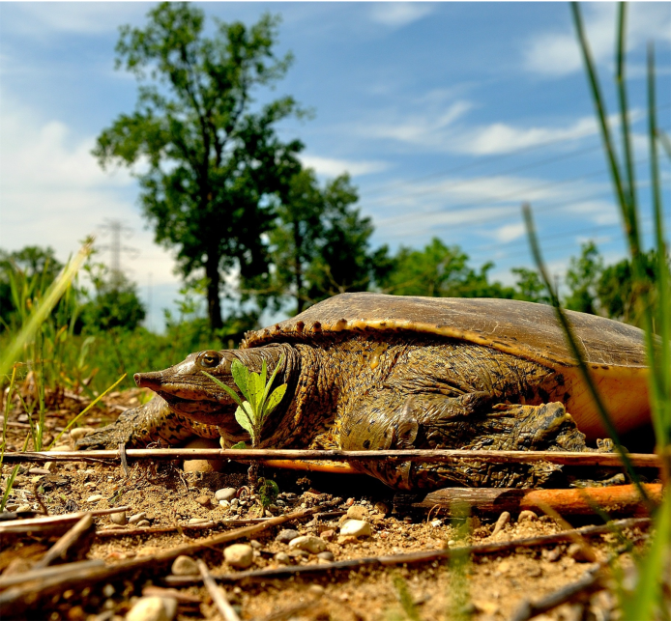
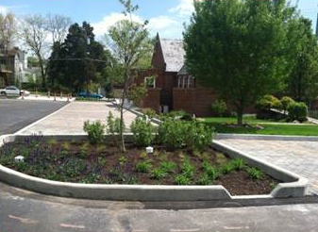
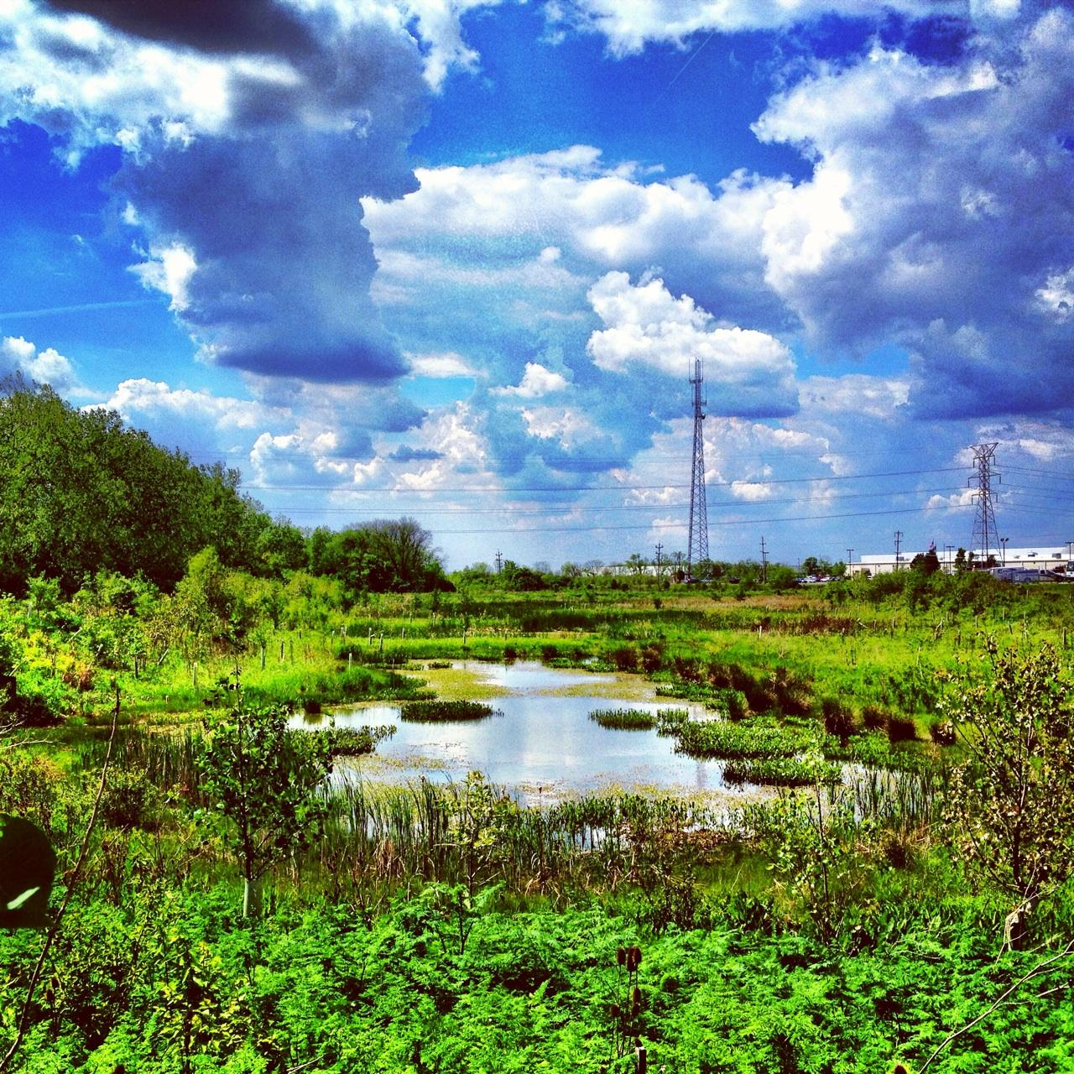
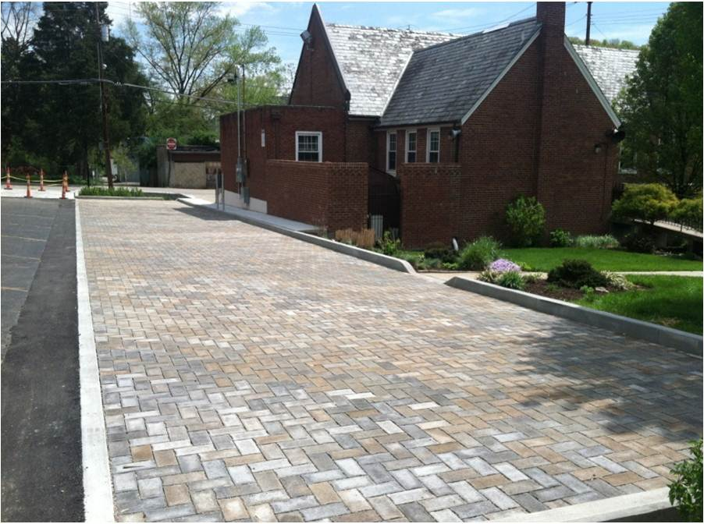
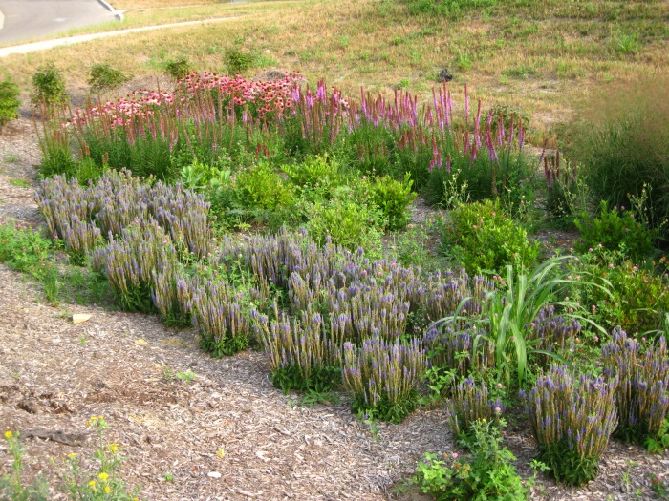
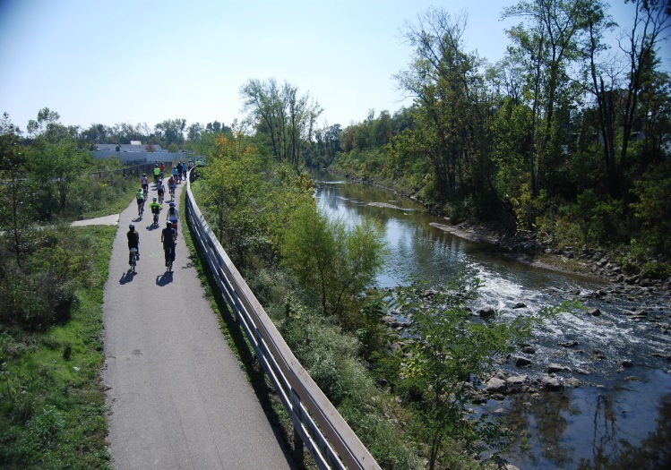
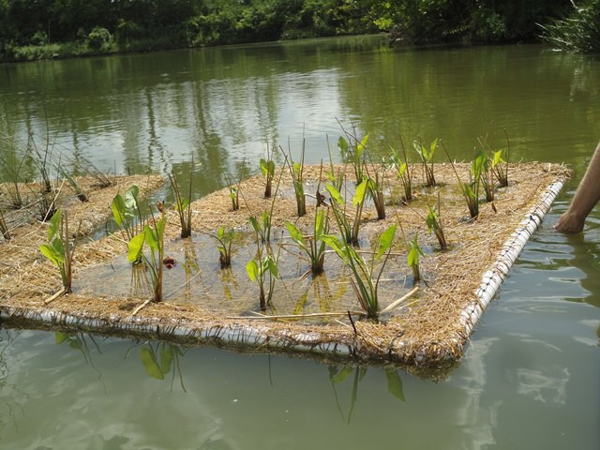
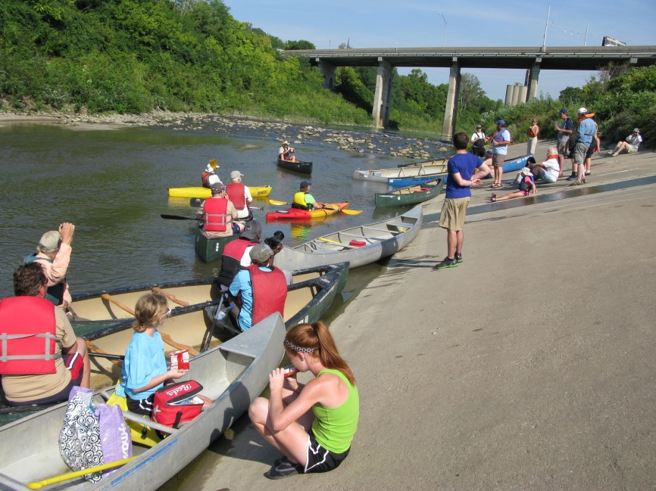
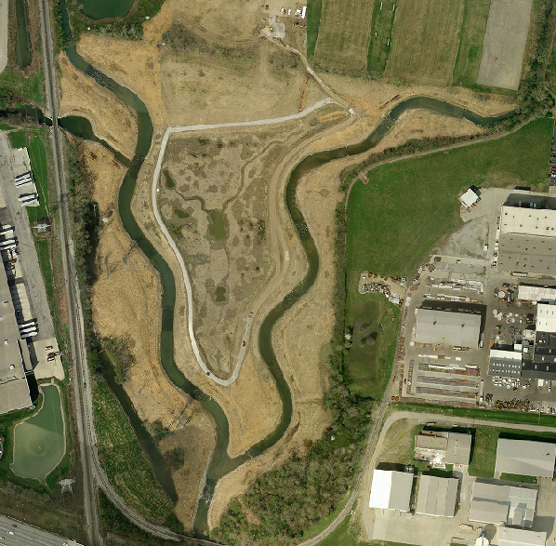

Slide 10
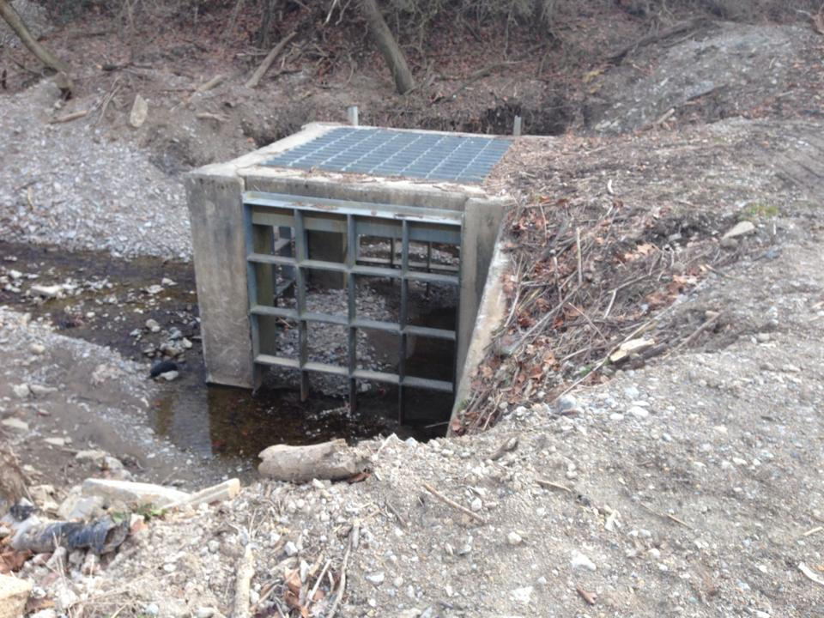

Slide 11
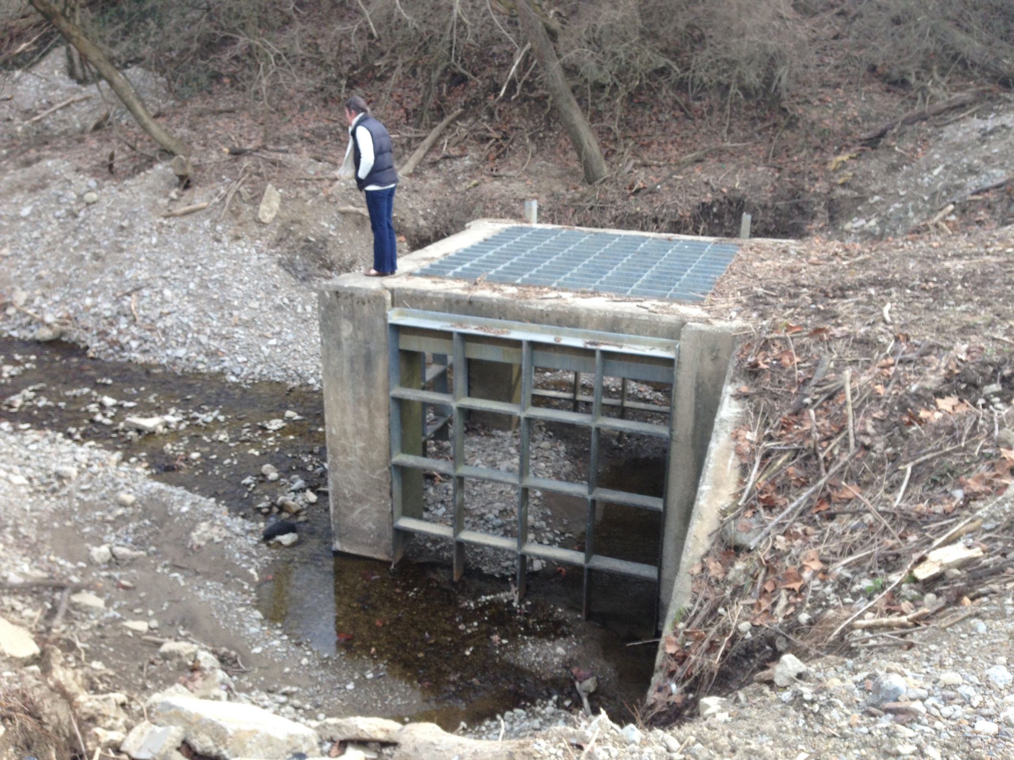

Slide 12
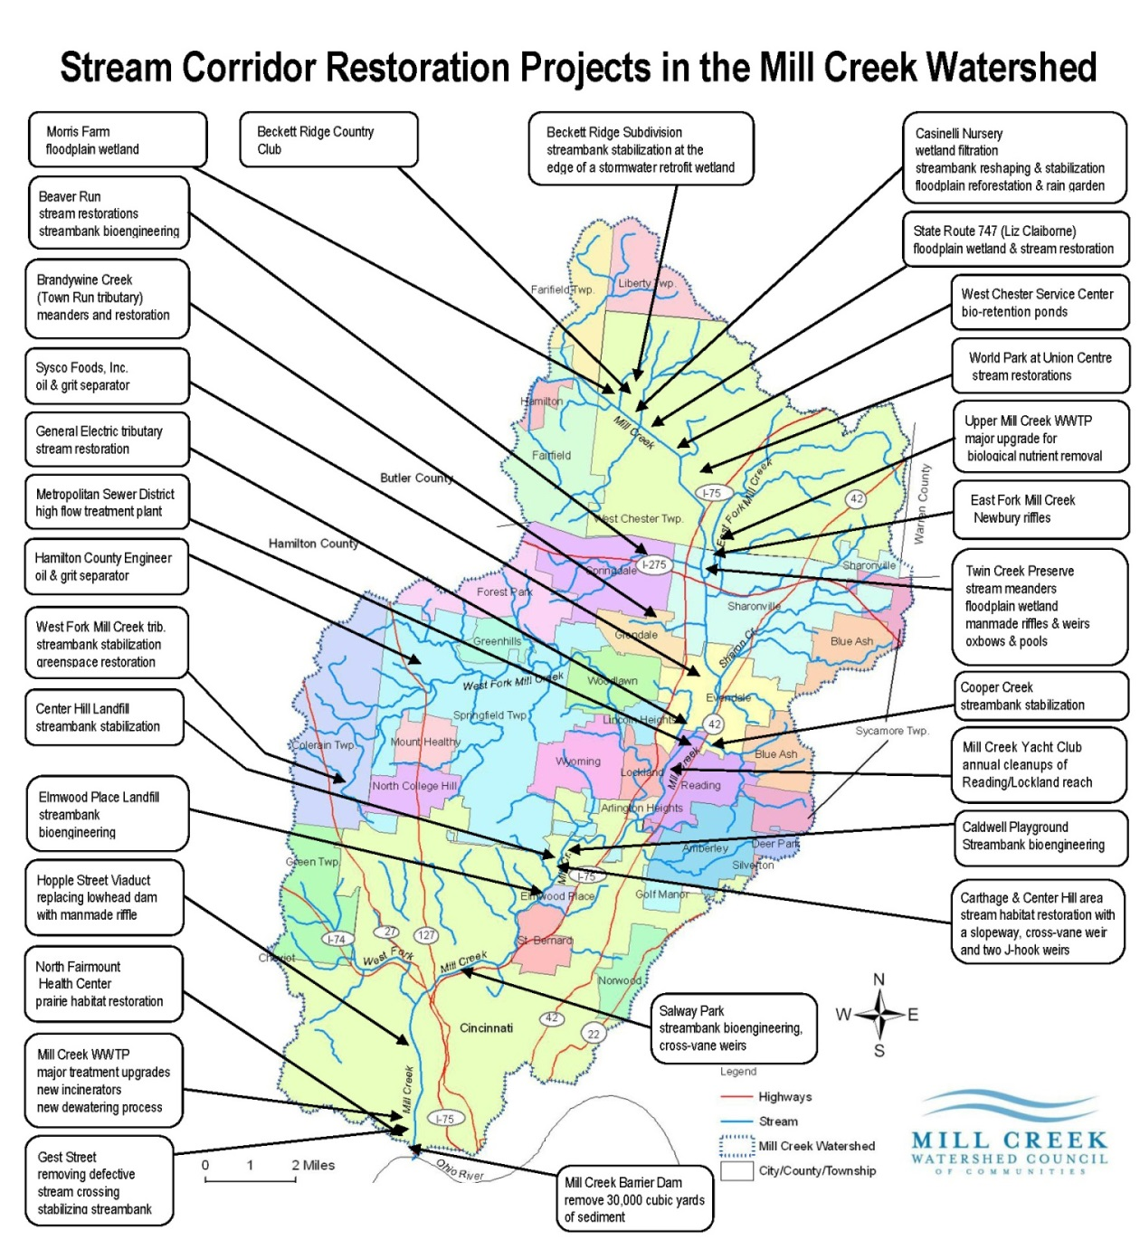
Most sites poor or very poor in 1992 and fair to marginally good in 2011
Of the 76 sites evaluated under the WWH suite: 11 were in full attainment of the applicable use tier (WWH‐5; MWH–4), 21 in partial attainment (WWH‐15; MWH‐6), and 46 were in non‐attainment (all WWH)
46 species of fish up from 33 species found in 1992
3 pollutant intolerant species up from only 1 found in 1992
Data cited from the Midwest Biodiversity Institute’s Biological and Water Quality Study of Mill Creek and its Tributaries 2011

Slide 13
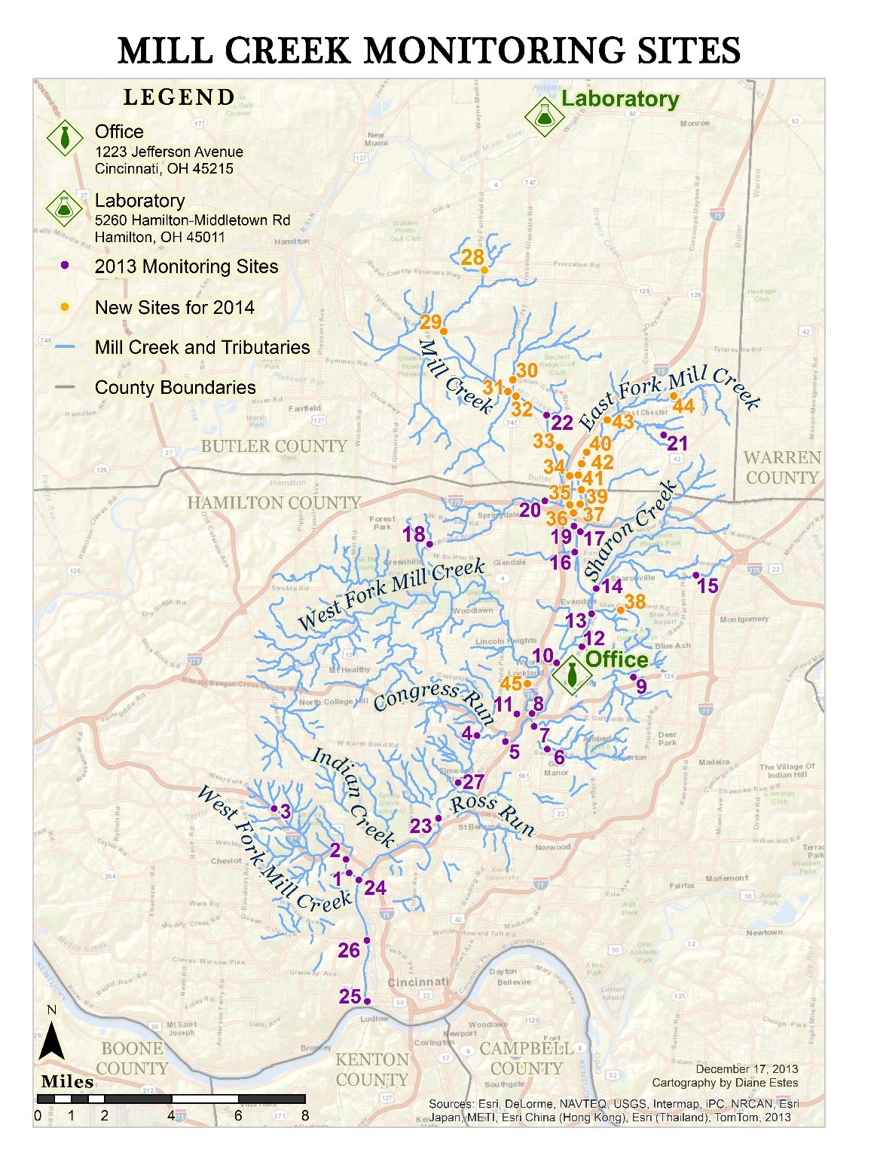
Mill Creek Volunteer Water Quality Monitoring Program
April-November, once per month
Grab samples analyzed for pH, TP, nitrate conductivity, turbidity, E coli
Provides a comprehensive and consistent set of quality data
45 regular volunteers
Mobile app for data entry and photo collection

Slide 14
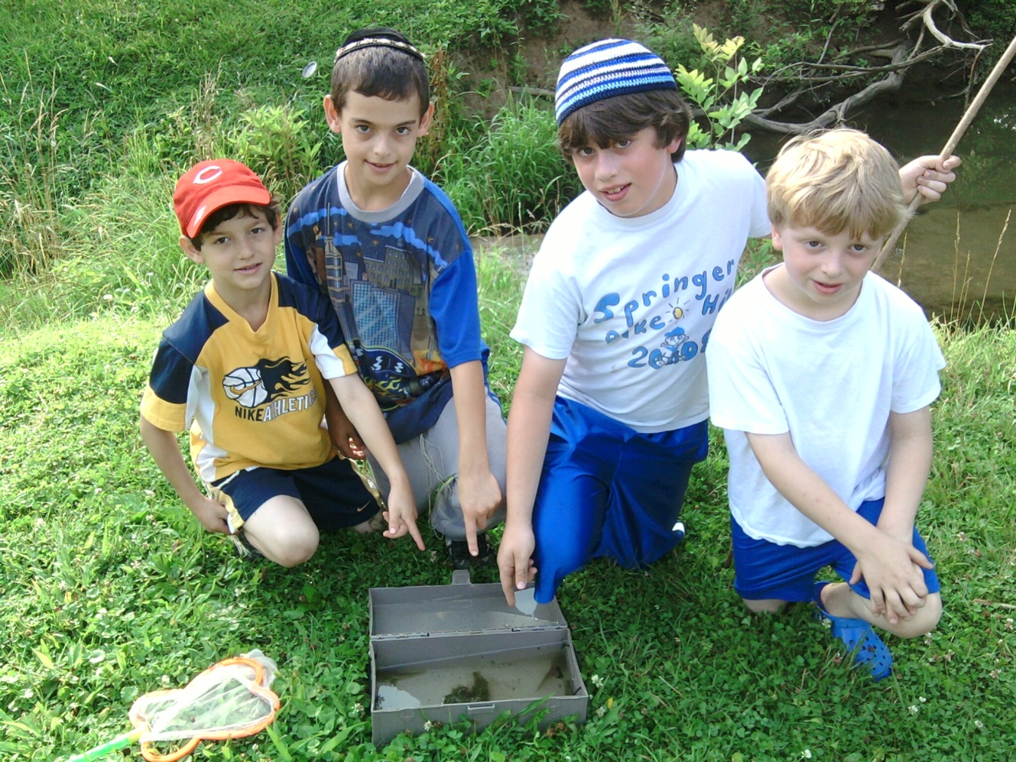
2013 Program Findings
Baseline of data collected and memorialized
Nutrients and bacteria are high however…
Stormwater quality varies by event and by location
Continue building a dependable database
Implement improvement projects and track results

Slide 15
Linking degradation of water quality to potential solutions:
Erosion / Sedimentation
Limited microbiology
Flooding
Stream channelization
Increased imperviousness
Lack of riparian corridor
Disturbed habitat
Roadway runoff
Over fertilizing
Poor oxygenation
Reduced floodplain
Overloaded sewer systems
Increased wet weather flows
Water chemistry
Temperature and flow fluctuations
Improvement Project Prescription

Slide 16
Screening project opportunities based on watershed specific needs:
Stakeholder Engagement
Floodplain Enhancement
Detention
Flow Control
Water Quality
Nutrients
Sediment
Chloride
Cost & Funding
Schedule
Land Availability
Volume Control
Community Needs
Refined Prescription

Slide 17
Project selection based on local needs:
Amenities
Return on Investment
Insufficient LOS
Performance
Improvement Project

Slide 18
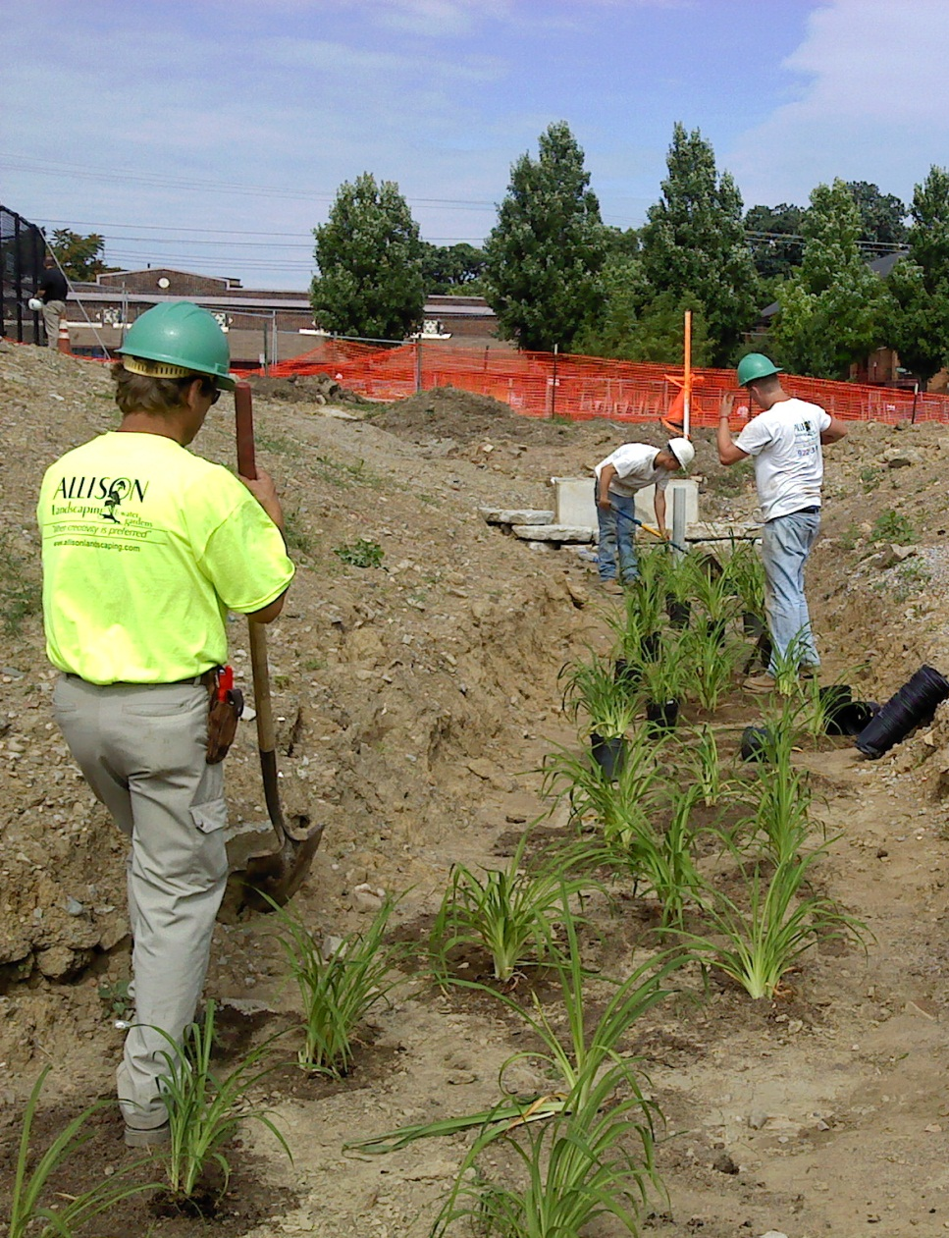
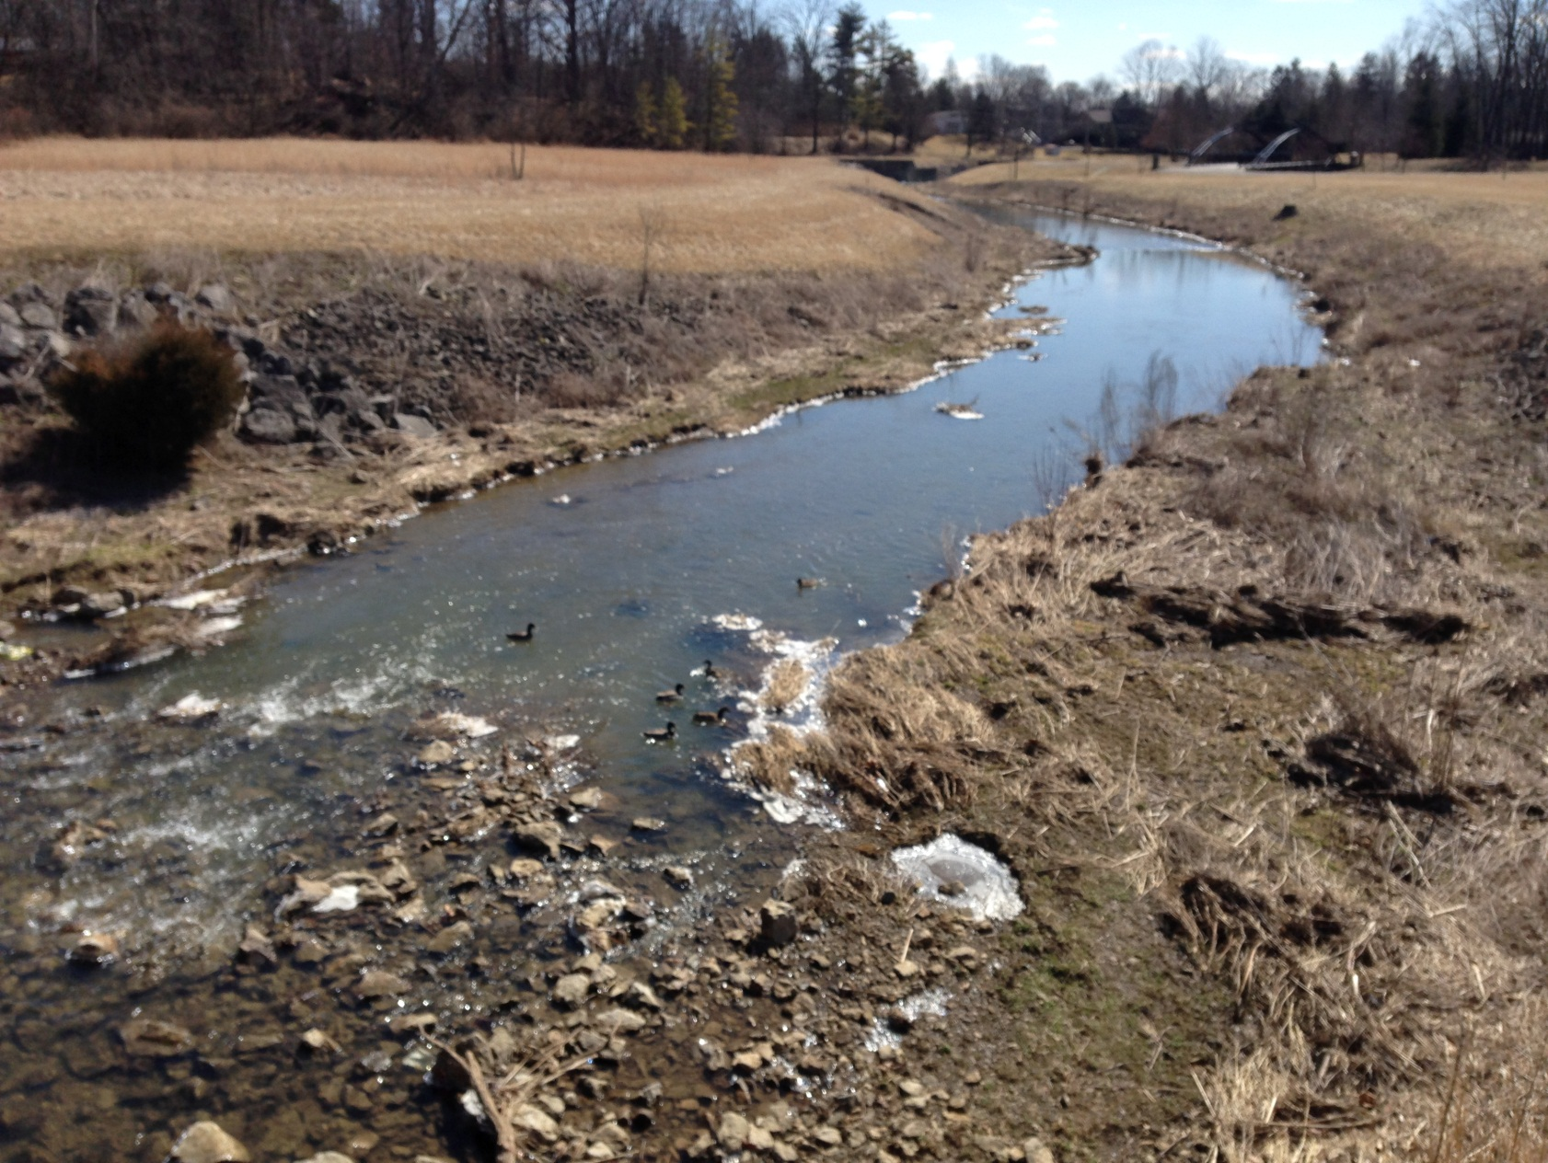
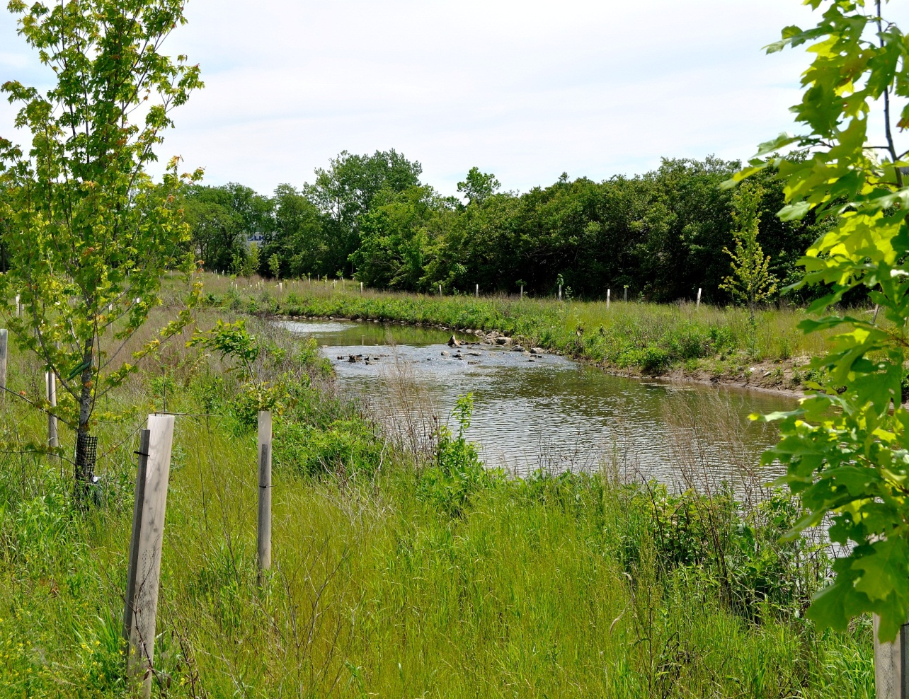
Improvement Projects
Should Provide:
Increased assimilative capacity
Habitat
Water chemistry
Flow control
Return on investment
Life cycle cost data
Performance metrics
Cost / performance ratio

Slide 19
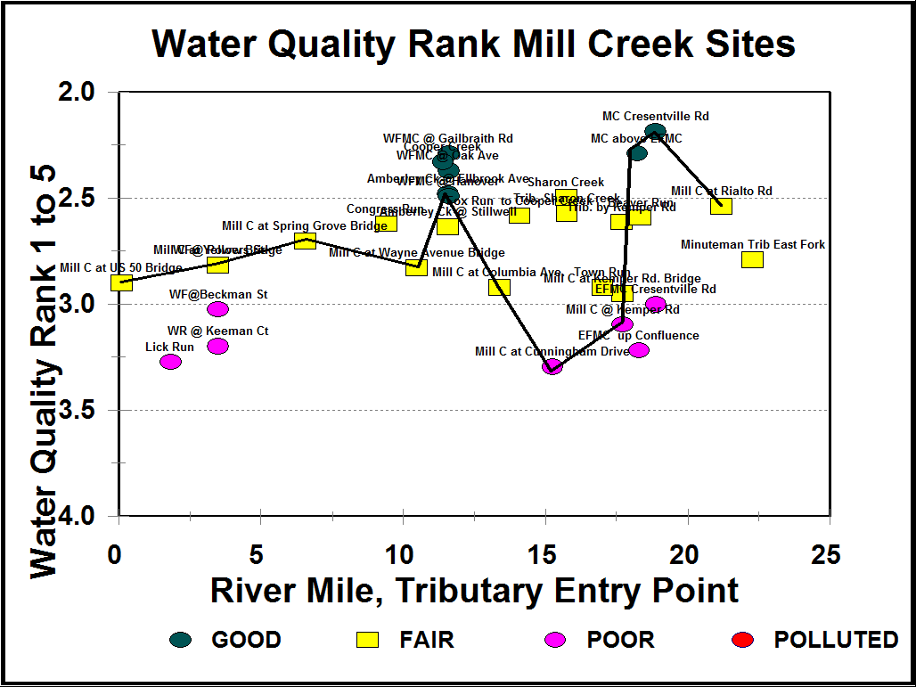
Strategic Investment of Limited Funding
Water quality and quantity improvements: attainment
Maintenance efficiencies
Habitat improvement
Recreation
Economic development
Quality of life
Notes:
Plotting tributaries at their point of entry into the Mill Creek as river miles from the Ohio River shows that in 2013 most of the sites were fair to poor. The Mill Creek above Cresentville Road is the only mainstem site in our sample regime to show good water quality for the year. Only 6 tribs sites were good or excellent = WWH, meeting the standard of the Clean Water Act (1972). The worst site was below the mixing of the EFMC with the MC at RM 17.5. Clearly the reservoirs treated water in the WFMC and Sharon Ck making them amongst the cleanest.

Slide 20
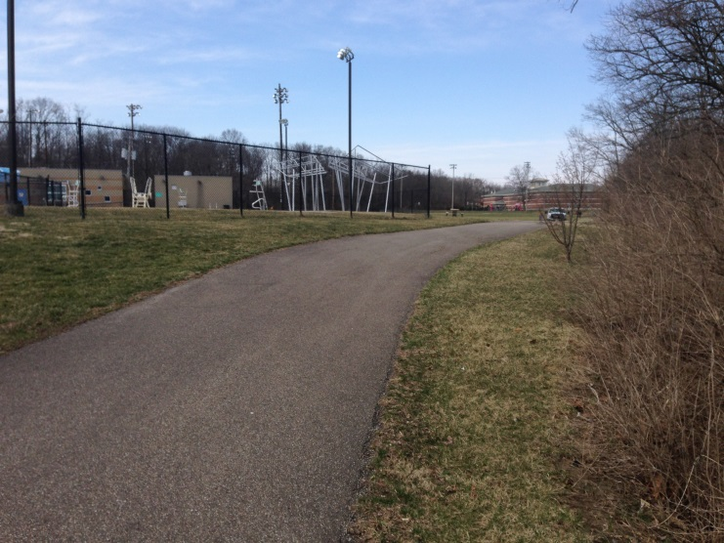
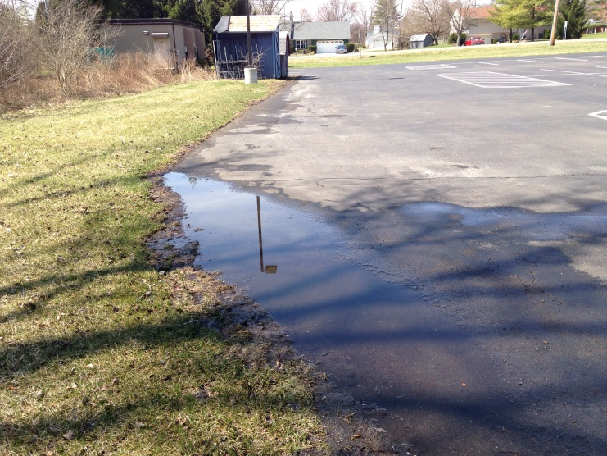
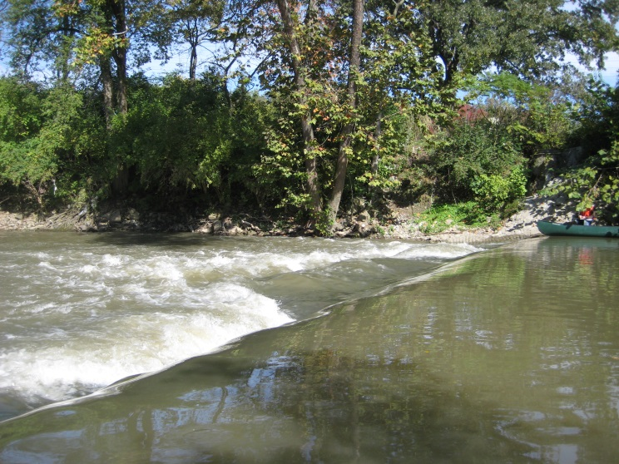
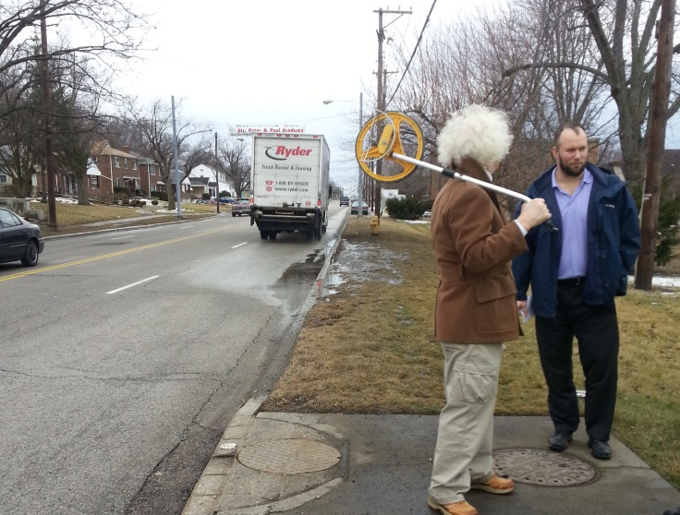
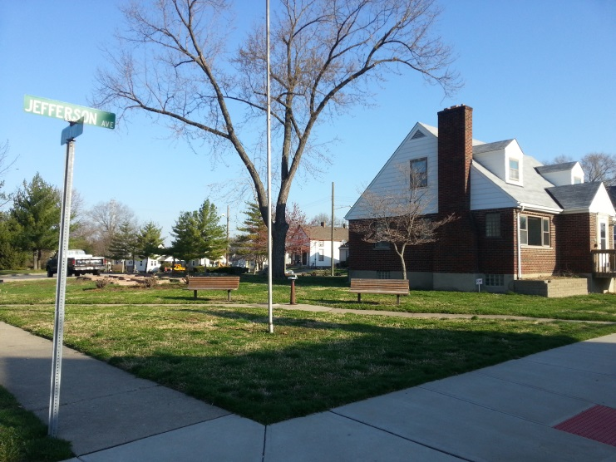
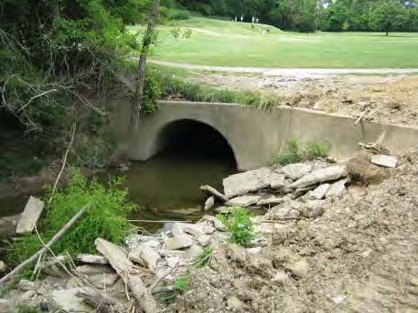
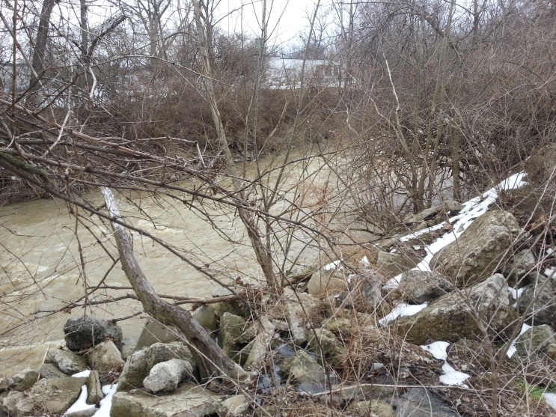
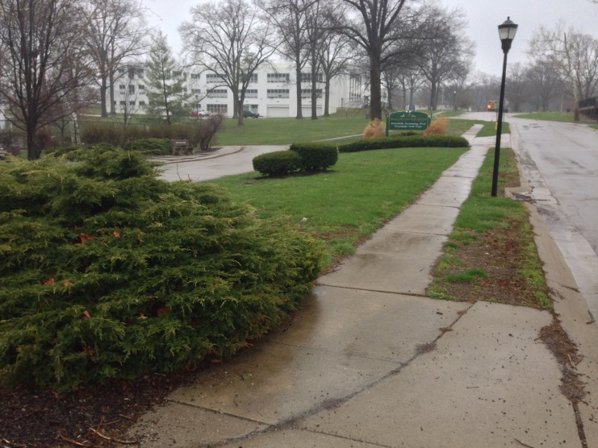
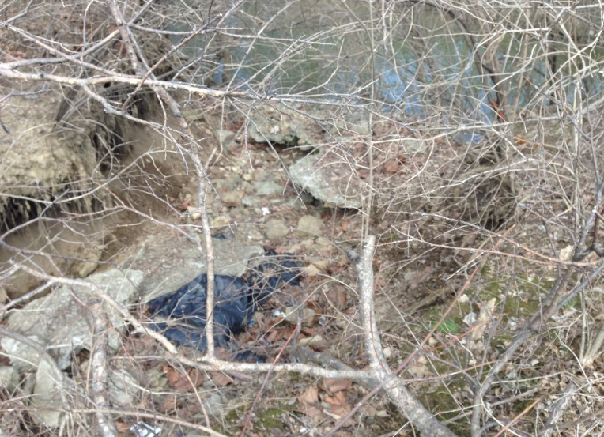

Slide 21
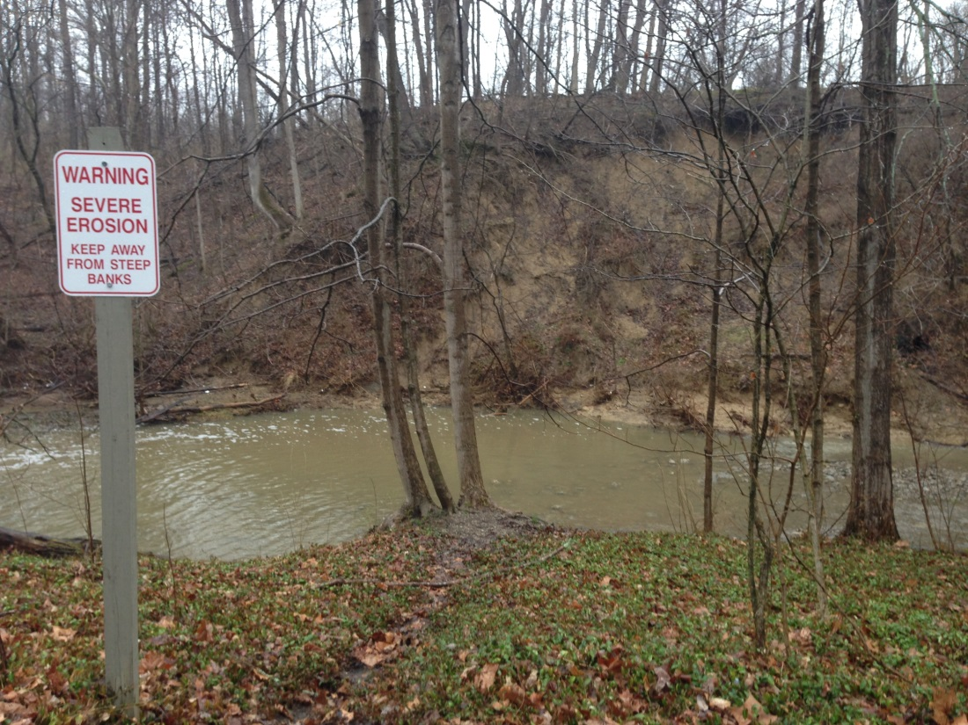
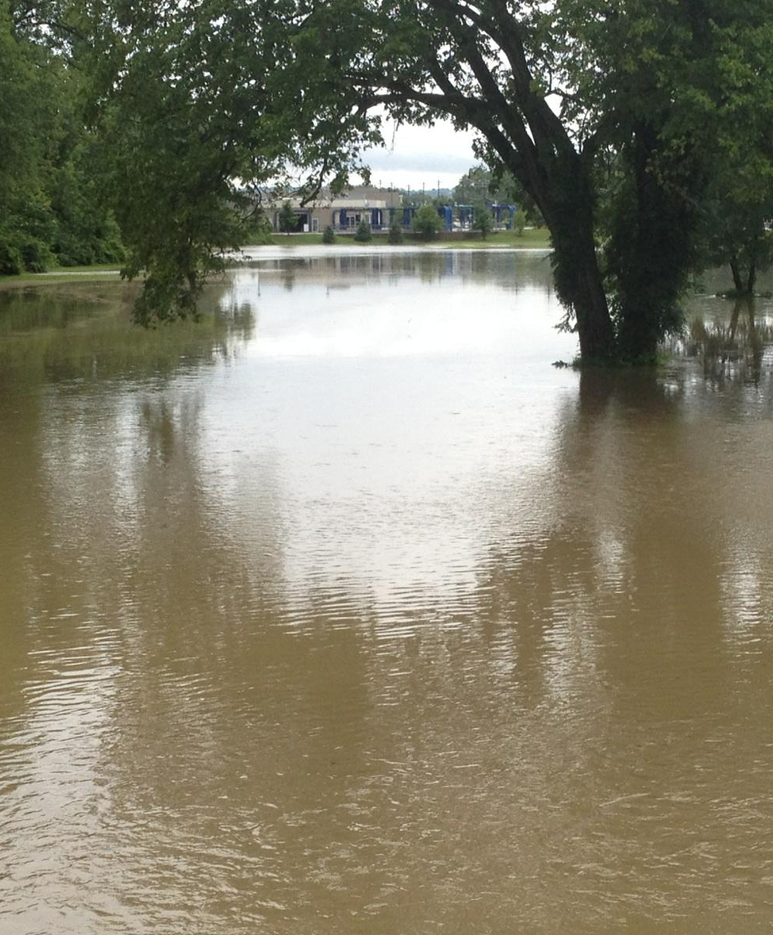
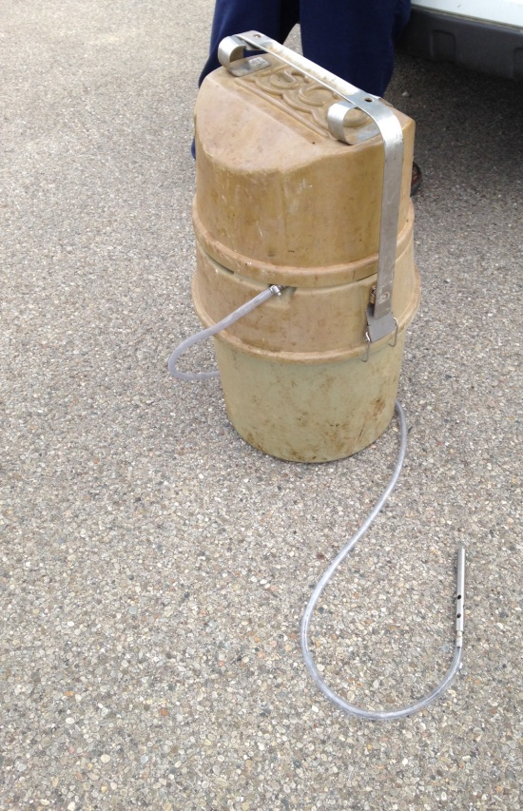
Moving Forward
Pre and post-construction flow and chemistry monitoring
Flow data at key locations in the watershed
Macroinvertebrate sampling
Succession of flora and fauna at restored wetland and stream sites
Continue building a dependable & statistically significant database

Slide 22
Five Components of a Comprehensive Monitoring Program
Water chemistry
Habitat/macroinvertebrates/QHEI
Biology/biocriteria
Flow
Geomorphology

Slide 23
The Vision:
An improved Mill Creek that is an asset to our region

Slide 24
The Vision:
An improved Mill Creek that is an asset to our region

Slide 25
Learn More
Session F4B – Friday 2:45 PM
Advancing the Mill Creek Watershed Monitoring Program through Innovative Technology
Kara Scheerhorn, Mill Creek Council of Communities

Slide 26
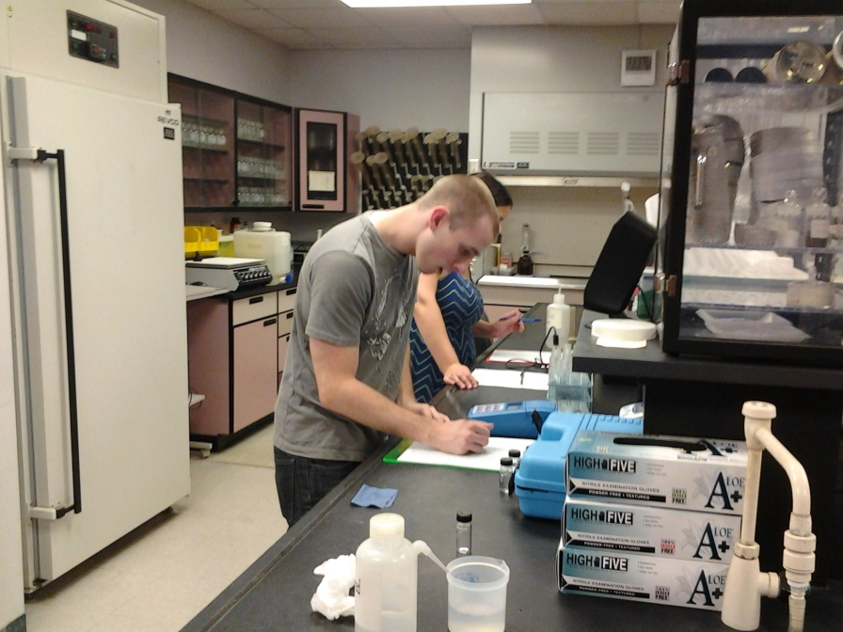
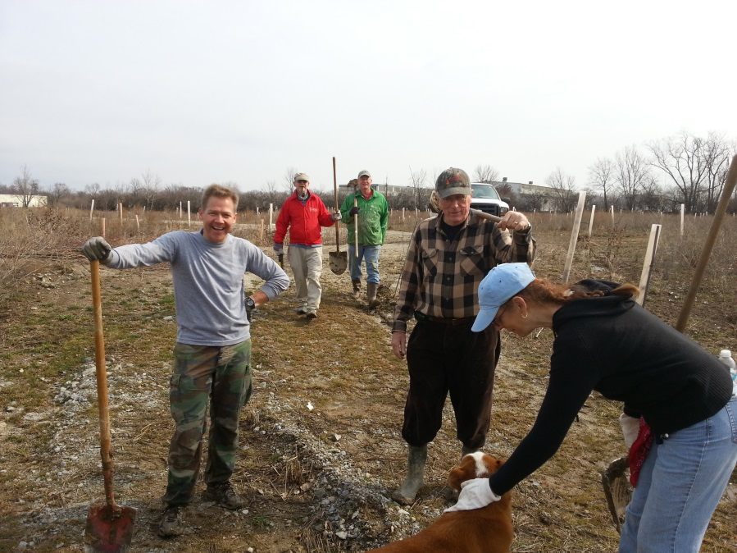
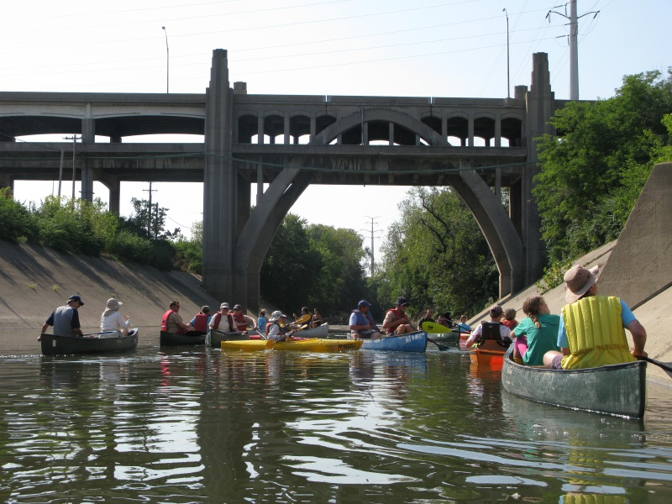
Jennifer Eismeier
Mill Creek Watershed Council
1223 Jefferson Avenue Reading, Ohio 45215
ph: 513.563.8800 jeismeier@millcreekwatershed.org
John Herchl, LEED AP, CPESC
CDM Smith
8800 Lyra Drive, Suite 500 Columbus, Ohio 43240
ph: 614.847.6880 herchljf@cdmsmith.com

Slide 27
Initial Program Goals
What are bank-full wetlands achieving in terms of peak flow attenuation? Can we see benefit of other constructed wetlands or basin retrofits?
Focus on water quality improvement in tributaries. Include education for private landowners, particularly on planting trees and riparian corridor management
Incorporate more than just chemistry
Target pulse flows including the “first flush” of small (less than 1-inch rainfall) storm events

Slide 28
Project Area
Completed projects where monitoring happening

Slide 29
Attainment of designated use (WWH)
The Mill Creek
Flood Plain
Habitat
TMDL
Flow
Nitrite/nitrate
Phosphorus
Reduced imperviousness
The Mill Creek
Flood Plain
Habitat
TMDL
Flow
Nitrite/nitrate
Phosphorus
The Mill Creek
Flood Plain
TMDL
Flow
Nitrite/nitrate
Phosphorus
The Mill Creek
TMDL
Flow
Nitrite/nitrate
Phosphorus
The Mill Creek
Flood Plain
Habitat
TMDL
Flow
Nitrite/nitrate
Phosphorus
Education
Reduced imperviousness

